Slide 1
NEW NARROW NUCLEON N*(1685)
M. V. Polyakov (Ruhr University Bochum & Petersburg NPI)
Prediction of narrow N*
“Neutron anomaly” in eta photoproduction
Possible interpretations
Evidence for narrow N* (1685) in beam asymmetry for
eta photoproduction on FREE proton
Conclusions and outlook
Brief and concentrated summary see:
V. Kuznetsov, M.V.P., JETP Lett., 88 (2008) 347
Detailed description of predictions and survey of data see:
V. Kuznetsov, M.V.P, et al., Acta Physica Polonica ,
39 (2008) 1949

Slide 2
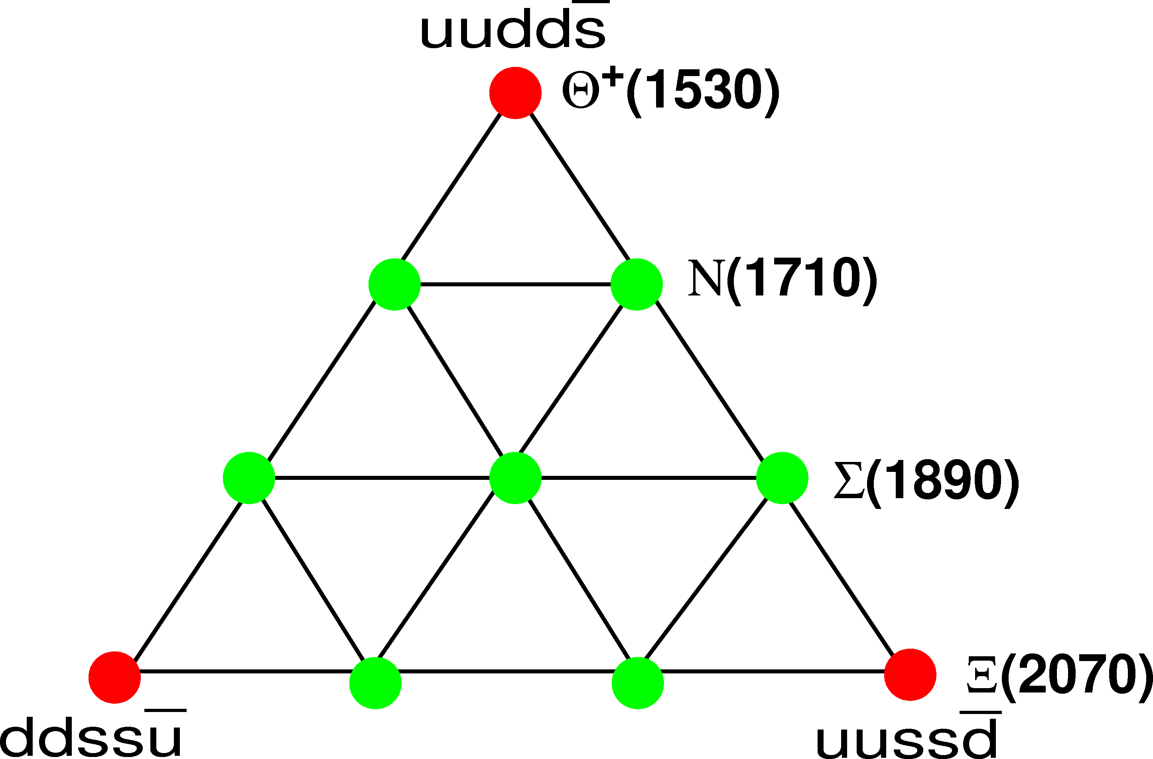
Anti-decuplet of baryons
D.Diakonov, V. Petrov, M.V.P., Z. Phys. A359 (1997) 302
I skip details of this predictions– just stress that it uses the picture of baryons as chiral solitons that is in many respects „abolish“ traditional quark model. The later model for the last 40 years guided the baryon spectroscopy. Maybe it is good time to reconsider the basics of the common view of the baryon spectrum?

Slide 3
Nonstrange pentaquark
Initially was identified with P11(1710)
/DPP ‘97/
Predicted properties:
- P11 quantum numbers
- weakly couples to pi N state,
narrow
- significantly couples to eta N
- photopropuction on proton is
suppressed by SU(3)
In 1997 very uncertain properties of P11(1710) were hardly but compatible with prediction
of soliton picture of baryons, also at that time for us it was hard to believe that one could miss
a narrow nucleon resonance around 1700 MeV after decades of baryon spectroscopy
programme.
In 2003 it became clear that P11(1710) can not be member of anti-decouplet, therefore
it was suggested in /R. Arndt, et al. PRC 69 (2004) 035208 / and
/D.Diakonov, V. Petrov PRD69 (2004) 094011/ an existence of new P11 narrow
nucleon resonance with the mass in 1700 MeV region.

Slide 4

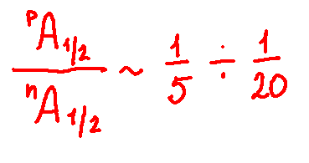
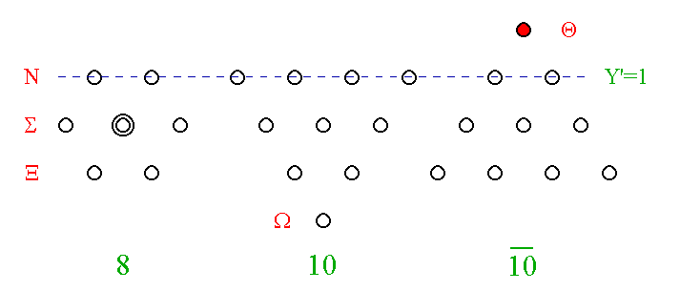
Photon has U-spin = 0. Good filter for multiplets
Anti-decuplet N* in the SU(3) limit can be photoexcited only from the neutron target
A. Rathke, M.V.P. EPJ A18 (2003) 691
I₃
Y

Slide 5
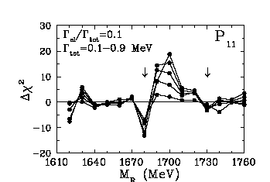
Modified PWA of pi N scattering – first hint on
new narrow N*(1680)
Arndt, Azimov, Strakovsky, Workman,MVP, PRC04
Main conclusions of MPWA:
mass ~1680
width< 30 MeV
Br(piN) < 5%
most probable quantum #‘s
P11
Br(eta N) ~ 10 -60 %
`` … given our present knowledge of the θ⁺, the state commonly known as the N(1710) is not the appropriate candidate to be a member of the antidecuplet. Instead we suggest candidates with nearby masses, N(1680) (more promising) and/or N(1730) (less promising, but not excluded). Our analysis suggests that the appropriate state should be rather narrow and very inelastic…”
/Arndt, Azimov, Strakovsky, Workman,MVP, PRC04
/

Slide 6
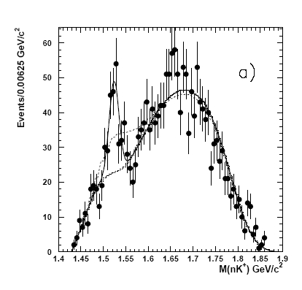
Theta update
Takashi Nakano, et al. (The LEPS Collaboration)
Evidence of the Theta^+ in the gamma d → K+K- pn reaction, arXiv:0812.1035, accepted to PRC
The most conservative estimate of significance
~ 5.2 sigma
In couple of monthes the „black box“ of blindly analyzed tripled data set will be opened.

Slide 7
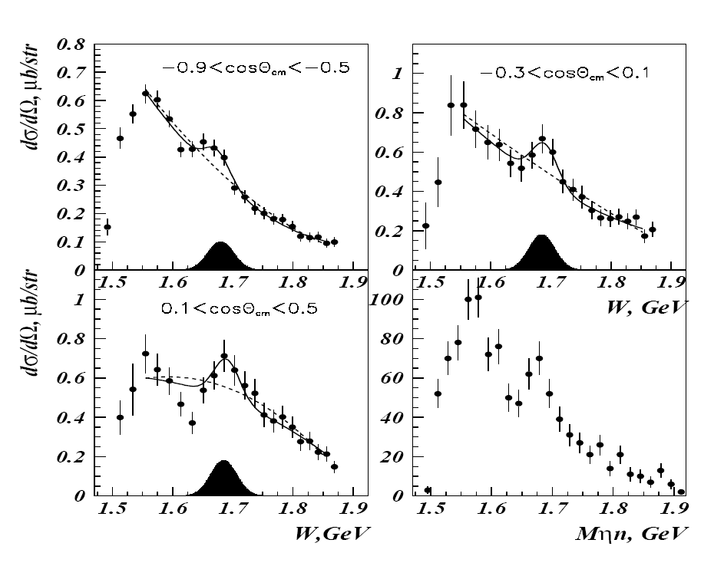
Eta photoproduction on the neutron. First observation of „neutron anomaly“ in GRAAL data.
V. Kuznetsov, et al., NSTAR‘’04, hep-ex/0409032
V. Kuznetsov, et al., Phys. Lett. 647 (2007) 23
Peak in
eta-neutron inv.
(not affected by
nuclear effects, only
resolution)
Mass ~1680 MeV
Bump in quasi-free cross-section: „neutron anomaly“ (affected by nuclear effects)

Slide 8
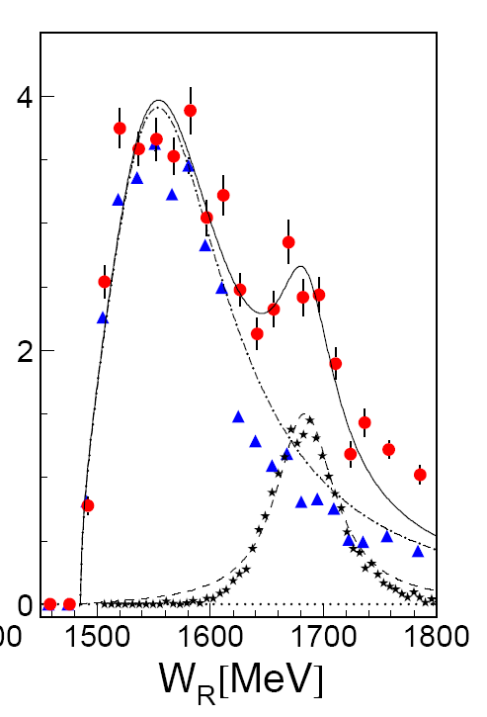
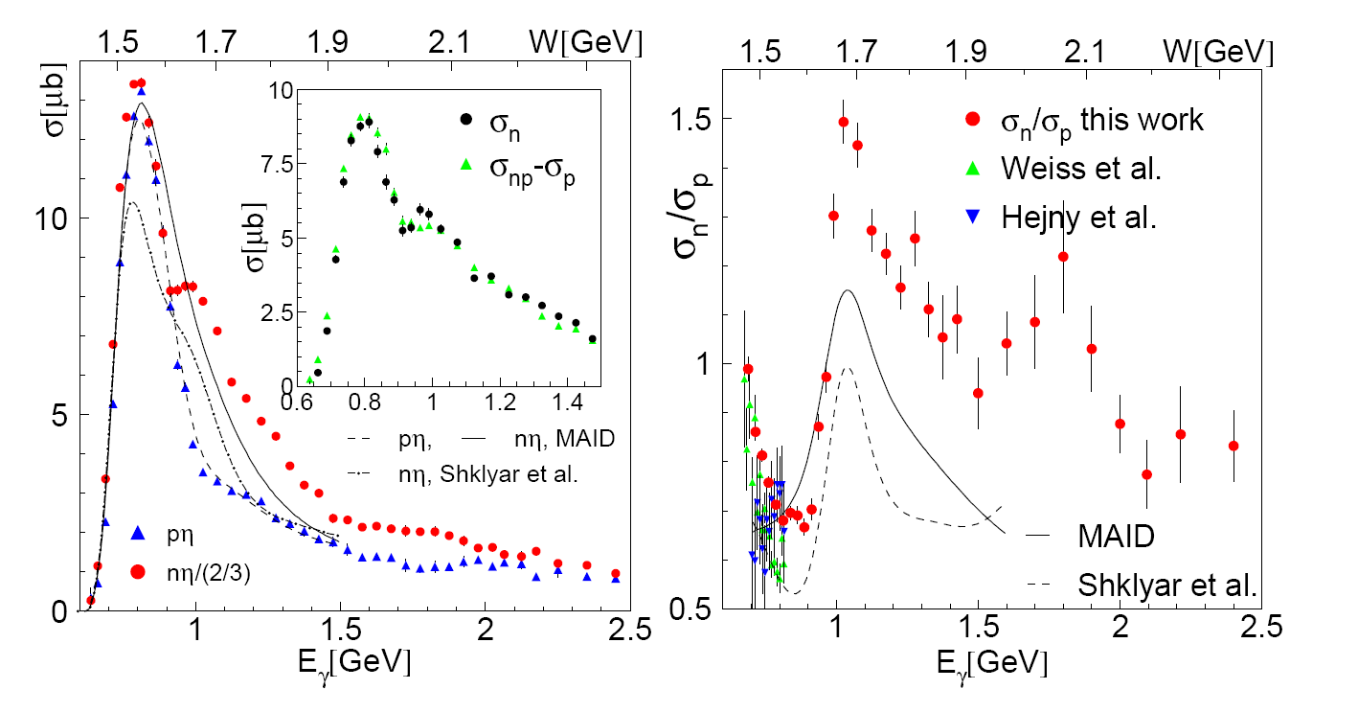
Eta photoproduction on the neutron. CB-ELSA/TAPS results.
I. Jaegle, et al., Phys. Rev. Lett. 100 (2008) 252002
Note that the „neutron anomaly“ is affected by the Fermi motion, rescattering effects and the procedure of extraction quasi-free cross section
Peak in the inv. mass is
Independent of these effects
Peak in
eta-neutron inv.
Mass ~1683 MeV
Bump in quasi-free cross-section: „neutron anomaly“

Slide 9
Eta photoproduction on the neutron. LNS-Tohoku result.
F. Miyahara et al. Progr. Theor. Phys. Suppl. 168 (2007) 90
CB-ELSA/TAPS and LNS-Tohoku confirmed the „neutron anomaly“ discovered by
V. Kuznetsov et al. in GRAAL data
CB-ELSA/TAPS also confirmed the presence of narrow peak in eta-n invariant mass.

Slide 10
Intrepretations of the „neutron anomaly“
New narrow nucleon resonance with much stronger photocoupling to neutron.
Was predicted before experiments as anti-decuplet member!
A. Rathke, M.V.P. EPJ A18 (2003) 691
R. Arndt, et al. PRC 69 (2004) 035208
D.Diakonov, V. Petrov PRD69 (2004) 094011
Effect of photo-excitation of D15(1675).
L.Tiator, et al. Eta- MAID, 2005
Coupled channel effect of S11(1650) and P11(1710) .
V. Shklyar, H. Lenske , U. Mosel , PLB650 (2007) 172
Either interference effects of S11(1535) and S11(1650) OR new narrow resonance
A. Anisovich et al. ArXiv: 0809.3340

Slide 11
Effect of photo-excitation of D15(1675).
L.Tiator, et al. Eta- MAID, 2005
Requires too large eta-N branching ratio – 17%
In PDG Br=1 %, also SU(3) analysis gives Br=2-3%
V. Guzey, MVP , 2005
Contradicts data on neutron beam asymmetry
A. Fantini, et al. PRC 78 (2008) 01523
Ruled out by the analysis of A. Anisovich et al. ArXiv:0809.3340

Slide 12
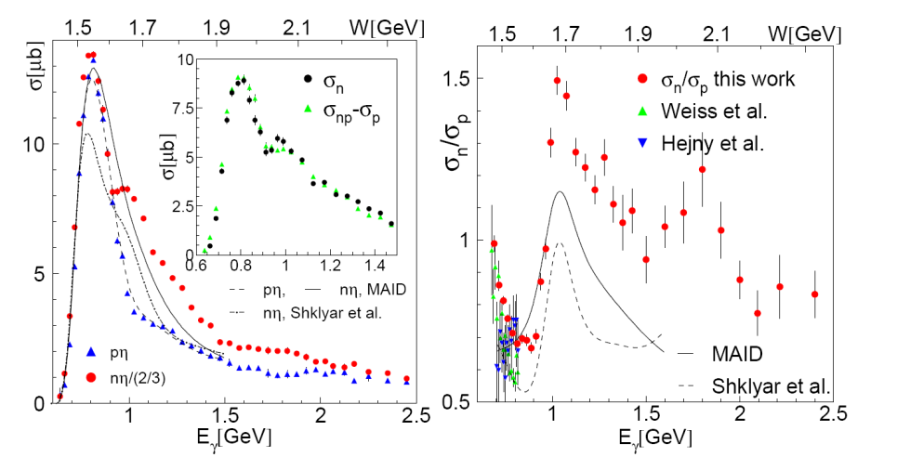

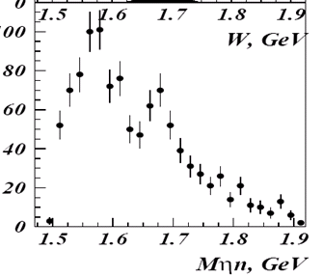
Coupled channel effect of S11(1650) and P11(1710) .
V. Shklyar, H. Lenske , U. Mosel , PLB650 (2007) 172
Interference effects of S11(1535) and S11(1650)
A. Anisovich et al. 0809.3340
Can not explain narrow peak in eta-neutron invariant mass observed by GRAAL and CB/TAPS
(widths of the peaks are ~40 and ~60 MeV )
Giessen and Bonn interpretations contradict each other! [A. Anisovich et al. ArXiv: 0809.3340 ]
Require „fine tuning“ of neutron photocouplings .
Predict absence of any narrow structure in the free proton channel observables

Slide 13
Eta-neutron invariant mass : not affected by nuclear effects
I. Jaegle, et al., Phys. Rev. Lett. 100 (2008) 252002
Explanation due to interference of known resonances can NOT
describe the peak in eta-N invariant mass.
The narrow resonance with parameters predicted by us 5 years ago easily describes this experimental result!
V. Kuznetsov, et al., NSTAR‘’04, hep-ex/0409032
V. Kuznetsov, et al., Phys. Lett. 647 (2007) 23

Slide 14
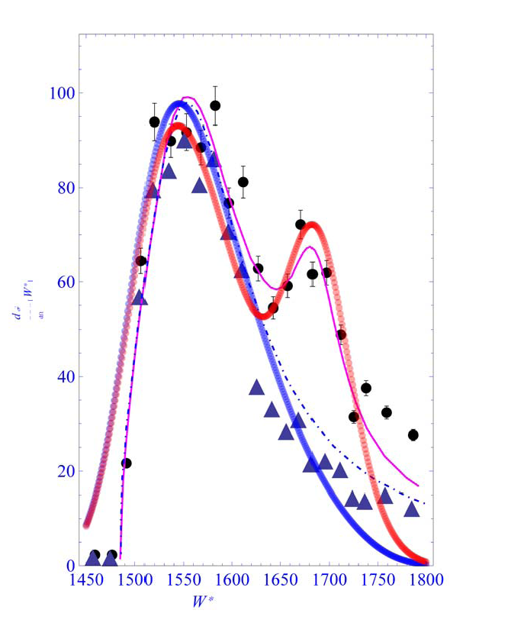
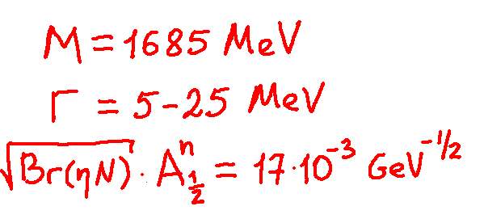
Calculation of eta-n invariant mass: SAID multipoles+ N*(1685)
added coherently (back of an envelope estimate)
The narrow resonance contribution to eta-N invariant mass smeared by experimental resolution (30 MeV Gaussian width).
Parameter of the resonance:
Parameters which has been predicted long before the
CB-ELSA/TAPS and GRAAL data!!! See:
A. Rathke, M.V.P. EPJ A18 (2003) 691
R. Arndt, et al. PRC 69 (2004) 035208
D.Diakonov, V. Petrov PRD69 (2004) 094011
YA. Azimov, V. Kuznetsov, I. Strakovsky, M.V.P. EPJ A25 (2004) 325
Kim, Praszalowicz, Yang, MVP, PRD71 (2005) 094023
Red curve (SAID + narrow N*(1685)) was obtained WITHOUT fitting!

Slide 15
A signal of N*(1685) in the photoproduction off FREE proton
is expected to be strongly suppressed as compared to
the neutron channel.
Rathke, M.V.P. EPJ A18 (2003) 691
Kim, Praszalowicz, Yang, MVP, PRD71 (2005) 094023
Therefore:
We choose to analyse photon beam asymmetry in which a weak resonance
signal is encanced via interference with a smooth contributions
See M. Amarian, D. Diakonov, MVP, PRD78 (2008) 074003 for uses of interference to reveal Theta+ signal from CLAS data
Narrowness of the signal requires careful studies of energy resolution and
fine energy binning
As the expected weak resonance signal is mostly due to interference
it is not necessarily has a form of a peak → „interference pattern
recognition“

Slide 16
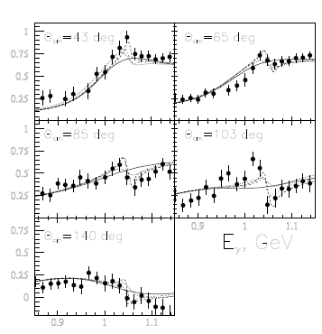

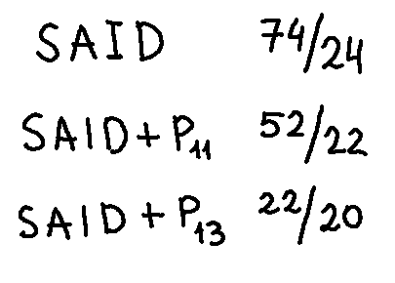
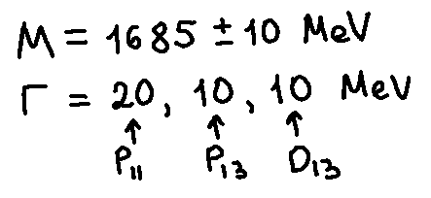
GRAAL beam asymmetry for eta photoproduction on free proton
with fine energy binning.
V. Kuznetsov, M.V.P, et al., hep-ex/0703003
V. Kuznetsov, M.V.P, et al., Acta Physica Polonica , 39 (2008) 1949
V. Kuznetsov, M.V.P., JETP Lett., 88 (2008) 347
One sees deviation of the data from SAID
solution in narrow inv. energy interval
W~1670 – 1710 MeV with pattern
similar to interference of a narrow
resonance with smooth amplitude.
Fit: smooth SAID multipoles + a resonance

Slide 17
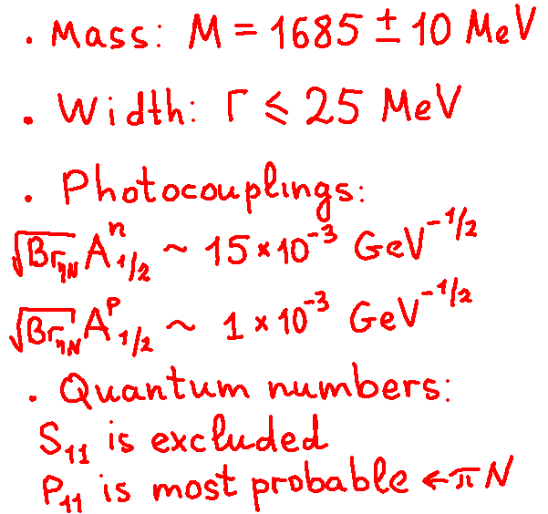
„Simple and consise explanation of recent data on eta photoproduction
is an existence of a new narrow nucleon resonance with properties“:
V. Kuznetsov, M.V.P., JETP Lett., 88 (2008) 347
V. Kuznetsov, M.V.P, et al., Acta Physica Polonica ,
39 (2008) 1949
Properties very similar
to that predicted for
N* from anti-decuplet:
Rathke, M.V.P. EPJ A18 (2003) 691
YA. Azimov, V. Kuznetsov, I. Strakovsky, M.V.P. EPJ A25 (2004) 325
R. Arndt, et al. PRC 69 (2004) 035208
D.Diakonov, V. Petrov PRD69 (2004) 094011

Slide 18
Conclusions
It seems that for many years we have been overlooking a narrow nucleon
resonance with mass 1685 MeV and with stronger photocoupling to the neutron.
Double polarization observables can be of big help to establish quantum numbers
of narrow N*(1685)! G.-S. Yang and M.V.P. in preparation
New narrow nucleon state – a challenge for standard PWA techinique,
we suggest to PWA groups to develope together new PWA procedure
based on Lagrange multiplyer method.
see, e.g. its application to analysis of polarized PDFs in Stratmann, Vogelsang, et al. PRL 101 (2008) 082001
„If you meet something, that looks, moves, smells and sounds like
an elephant, that is .....
really an elephant“
(children saying:)

Slide 19
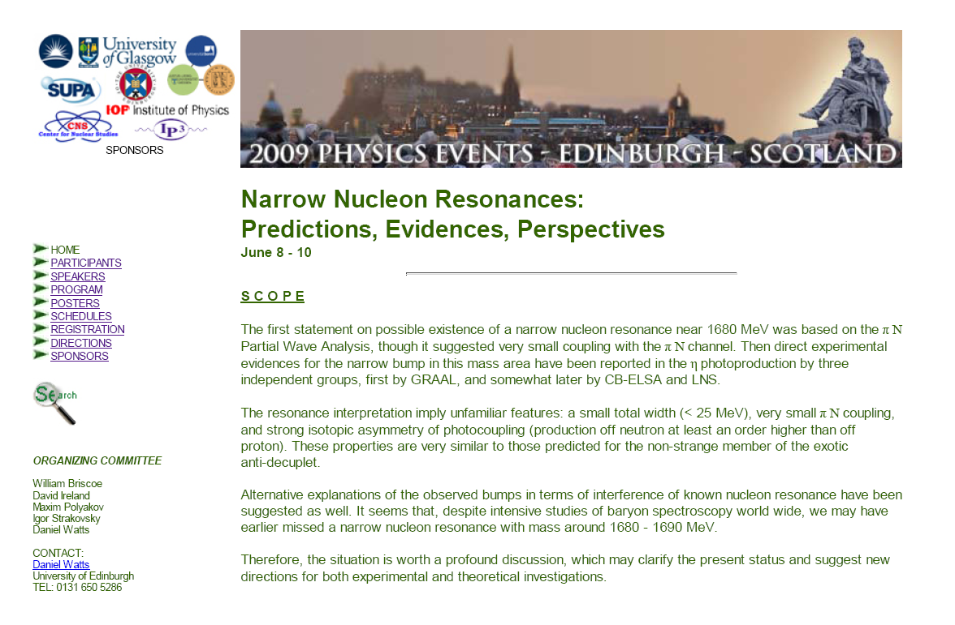
Focused workshop in Edinburgh, June 8-10
Many prominent speakers, we expect announcenments of new interesting results!
You are wellcome!
http://www.2009physicsevents.org/

