Slide 1
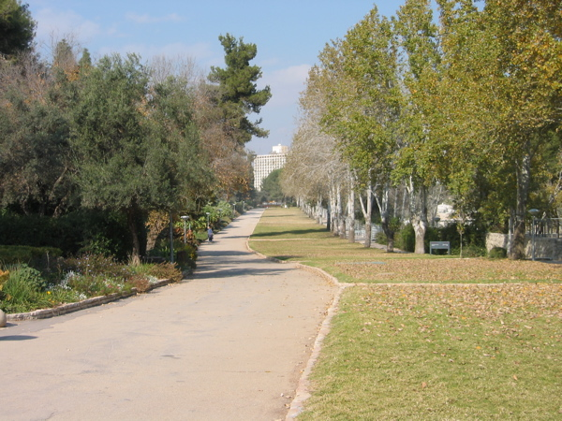
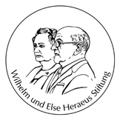
The power of χEFT: Connecting Nuclear Structure and Weak Reactions
474th International Wilhelm und Else Heraeus Seminar on
Strong interactions: From methods to structures
Doron Gazit

Slide 2
Outline
Calculating weak reactions in χEFT.
Nuclear Structure from weak reactions:
Constraining 3NF parameter using the triton β-decay.
Two-body contributions to Gamow-Teller transitions:
β-decay rate of ⁶He.
0νββ decay rates at medium-heavy nuclei.
Summary.
More accurate
complexity
Less accurate
Goal: Convincing you that χEFT is a pragmatic tool
to teach us how to simplify complicated physical problems,
reduce uncertainties, and eventually give quantitative results.

Slide 3
Introduction
What’s so great about reactions with weak probes?
One can immediately relate electro-weak reaction of a probe with nucleus to currents inside the nucleus.
The currents are reflections of the symmetries and properties of the nuclear interaction, in particular can be used to characterize the elusive three nucleon force.
Thus, one can relate electro-weak properties and reaction rates with non-trivial properties not only of the target, but also of the fundamental theory leading to its structure!
Lepton current
Nuclear current
Scattering operator
Currents in the nucleus

Slide 4
Introduction
Nuclear weak processes play a major role in:
Astrophysical phenomena.
Stellar evolution and solar fusion.
Supernovae.
Nucleosynthesis of the elements.
Nuclear structure: Giant Gamow-Teller resonance, Fermi and GT Strength Functions.
Superallowed Fermi transitions: isospin symmetry breaking, CKM matrix unitarity.
³H single β-decay: measurement of the neutrino mass
0νββ decay: Lepton Number Conservation, Majorana nature of neutrinos
Accurate, parameter free predictions are needed to describe the dynamics of astro phenomena or to decide whether an experiment is worth building.

Slide 5
Weak currents in the nucleus
The standard model dictates only the structure of the currets:
Charged current
Neutral current:
The current of polar (axial) vector symmetry is the Noether current of the QCD Lagrangian, with respect to SU(2)_{V} [SU(2)_{A}] symmetry.
Currents are not conserved, in general.
In χPT, the currents are derived from the chiral Lagrangian.
To our order, vector current is conserved in χPT (CVC).

Slide 6
Chiral Effective Field Theory
Symmetries are important NOT degrees of freedom.
In QCD – an approximate chiral symmetry:
The u and d quarks are (almost) massless (~5-10 MeV).
The SU(2)_{V} symmetry is the isospin symmetry.
The pions are the Nambu-Goldstone bosons of the spontaneous chiral symmetry breaking.
The order-parameter is the pion-decay constant: Λ_{QCD}=4πf_{π}
Identify Q – the momentum scale of the process.
In view of Q-identify the effective degrees of freedom:
Since Q~m_{π}<<Λ then the effective theory should consist of both pions and nucleons (pionfull χPT).
Write a Lagrangian composed of ALL possible operators invariant under symmetries of the underlying theory.

Slide 7
Chiral Effective Field Theory
Find a systematic way to organize diagrams according to their contribution to the observable.
Expand in the inverse of the nucleon’s mass (take Λ^{α}~M_{N}) ➔Heavy Baryon χPT!
Weinberg’s Power Counting: Each Feynman diagram can be characterized by:
Weinberg showed that ν is bound from below.
20 years of debate led by: Weinberg, Kaplan, Savage, Wise, van-Kolck, Nogga, Timmermans,Birse, Meissner, Epelbaum, Machleidt…

Slide 8
χPT approach for low-energy EW nuclear reactions:
QCD
Low energy EFT
Chiral Lagrangian
Nuclear potential
Nöther current
Wave functions
Weak current
Nuclear Matrix Element

Slide 9
Links between operators e.g., 3 body forces and reactions
van Kolck (1995); van Kolck, Ordonez (1995)…

Slide 10
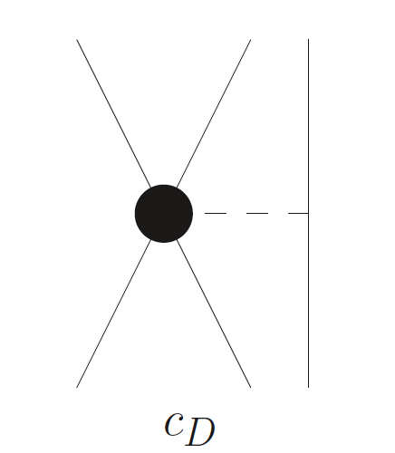
Links between operators e.g., 3 body forces and reactions
πNN absorption
Nöther current
Nuclear potential
Same LEC appears in the potential and in the current!
van Kolck (1995); van Kolck, Ordonez (1995); Gårdestig, Phillips (2006); DG, Quaglioni, Navratil (2009)

Slide 11
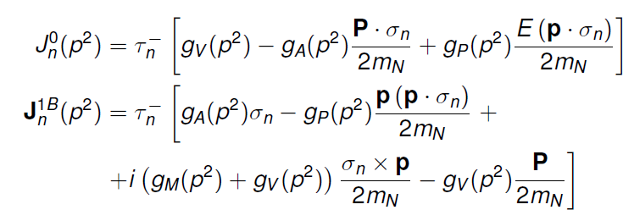
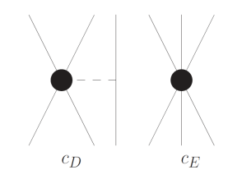
χPT axial weak currents to O(Q³)
Single nucleon current
1 pion exchange
Contact term
O(Q⁰), O(Q²)
O(Q³)
Fermi operator
Gamow-Teller operator
Nucleon-pion interaction, NO new parameters
Contact term
Gårdestig, Phillips, Phys. Rev. Lett. 98, 232301 (2006); DG, Quaglioni, Navratil, Phys. Rev. Lett. 103, 102502 (2009).
T.-S. Park et al, Phys. Rev. C 67, 055206 (2003); DG PhD thesis arXiv: 0807.0216

Slide 12
β decays
e

Slide 13
Nuclear β decays
Typically, a very low momentum transfer.

Slide 14
Triton β decay
Using accurately measured decay rate to calibrate the 3NF.
DG, Quaglioni, Navratil, Phys. Rev. Lett. 103, 102502 (2009)

Slide 15
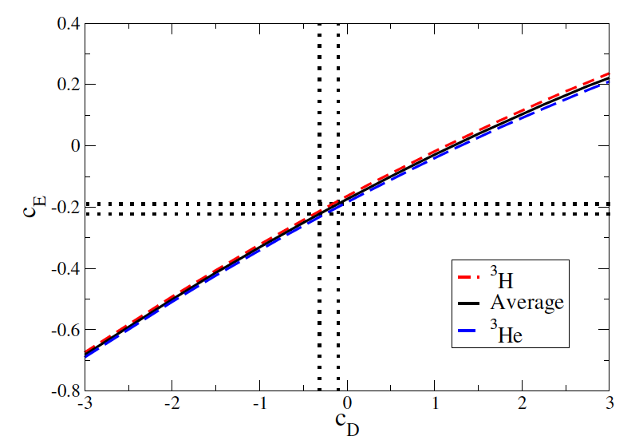
Step 1: use the trinuclei binding energies to find a c_{D}-c_{E} relation
Navratil et al., Phys. Rev. Lett. 99, 042501 (2007).

Slide 16
Step 2: calibrate c_{D} according to the triton half life.
N³LO EM 550

Slide 17
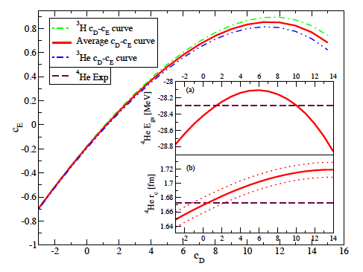
A prediction of ⁴He properties

Slide 18
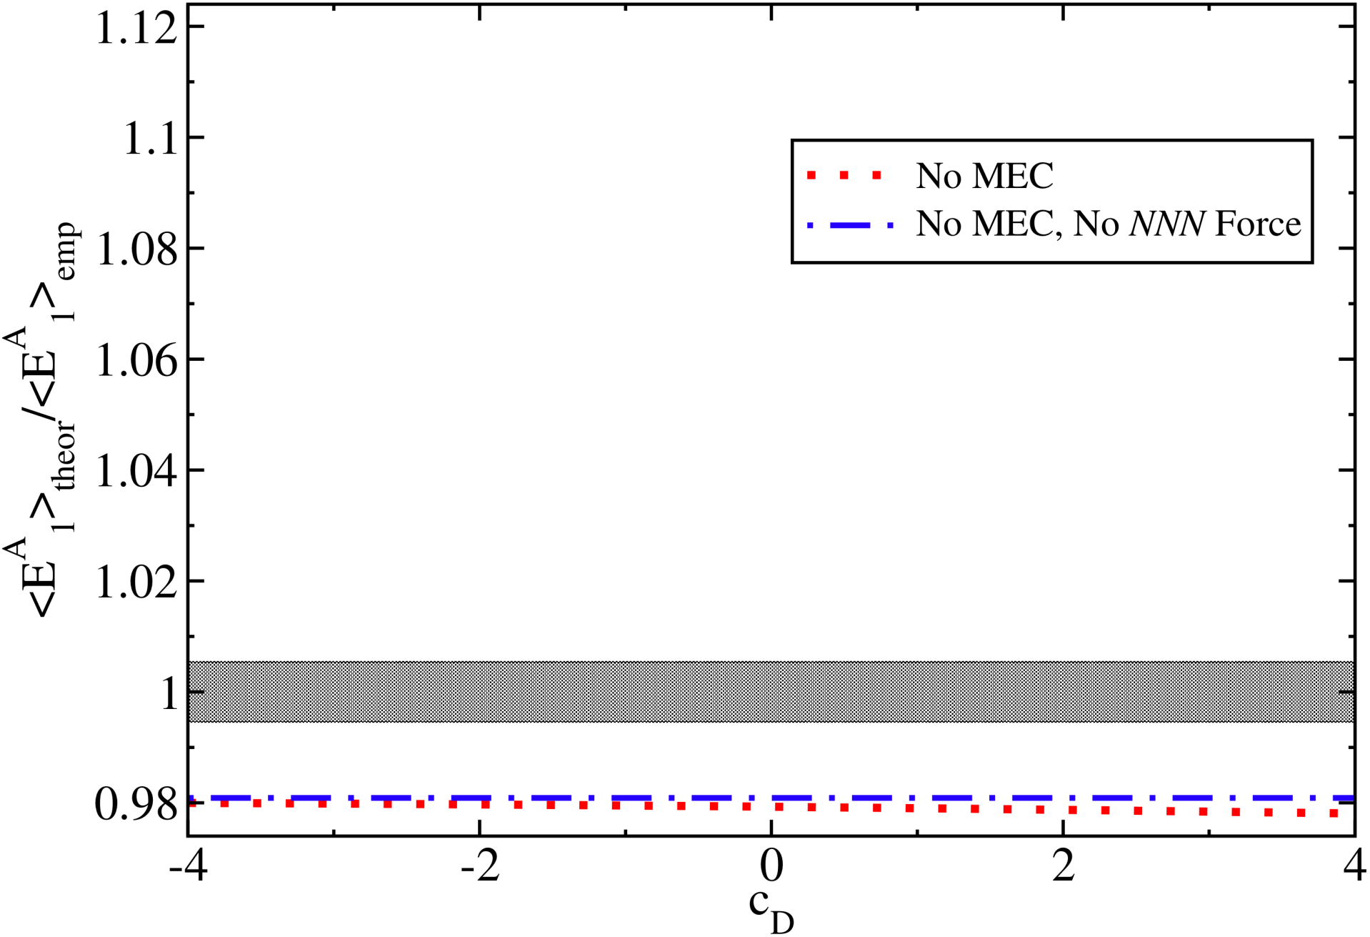
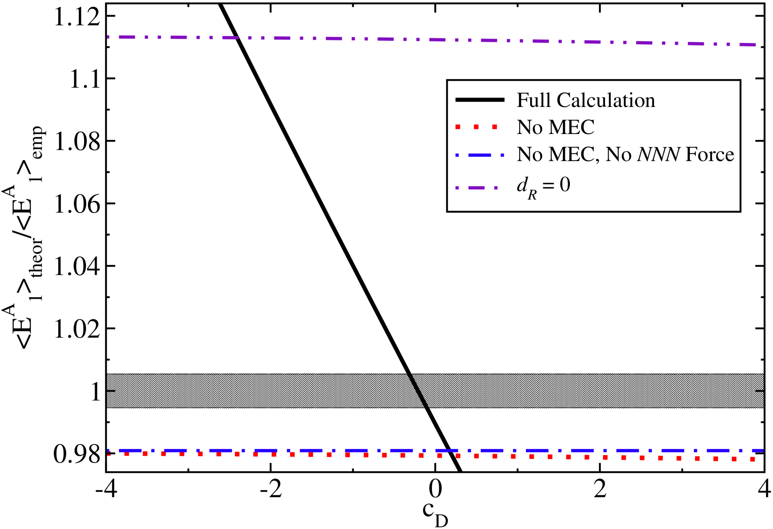
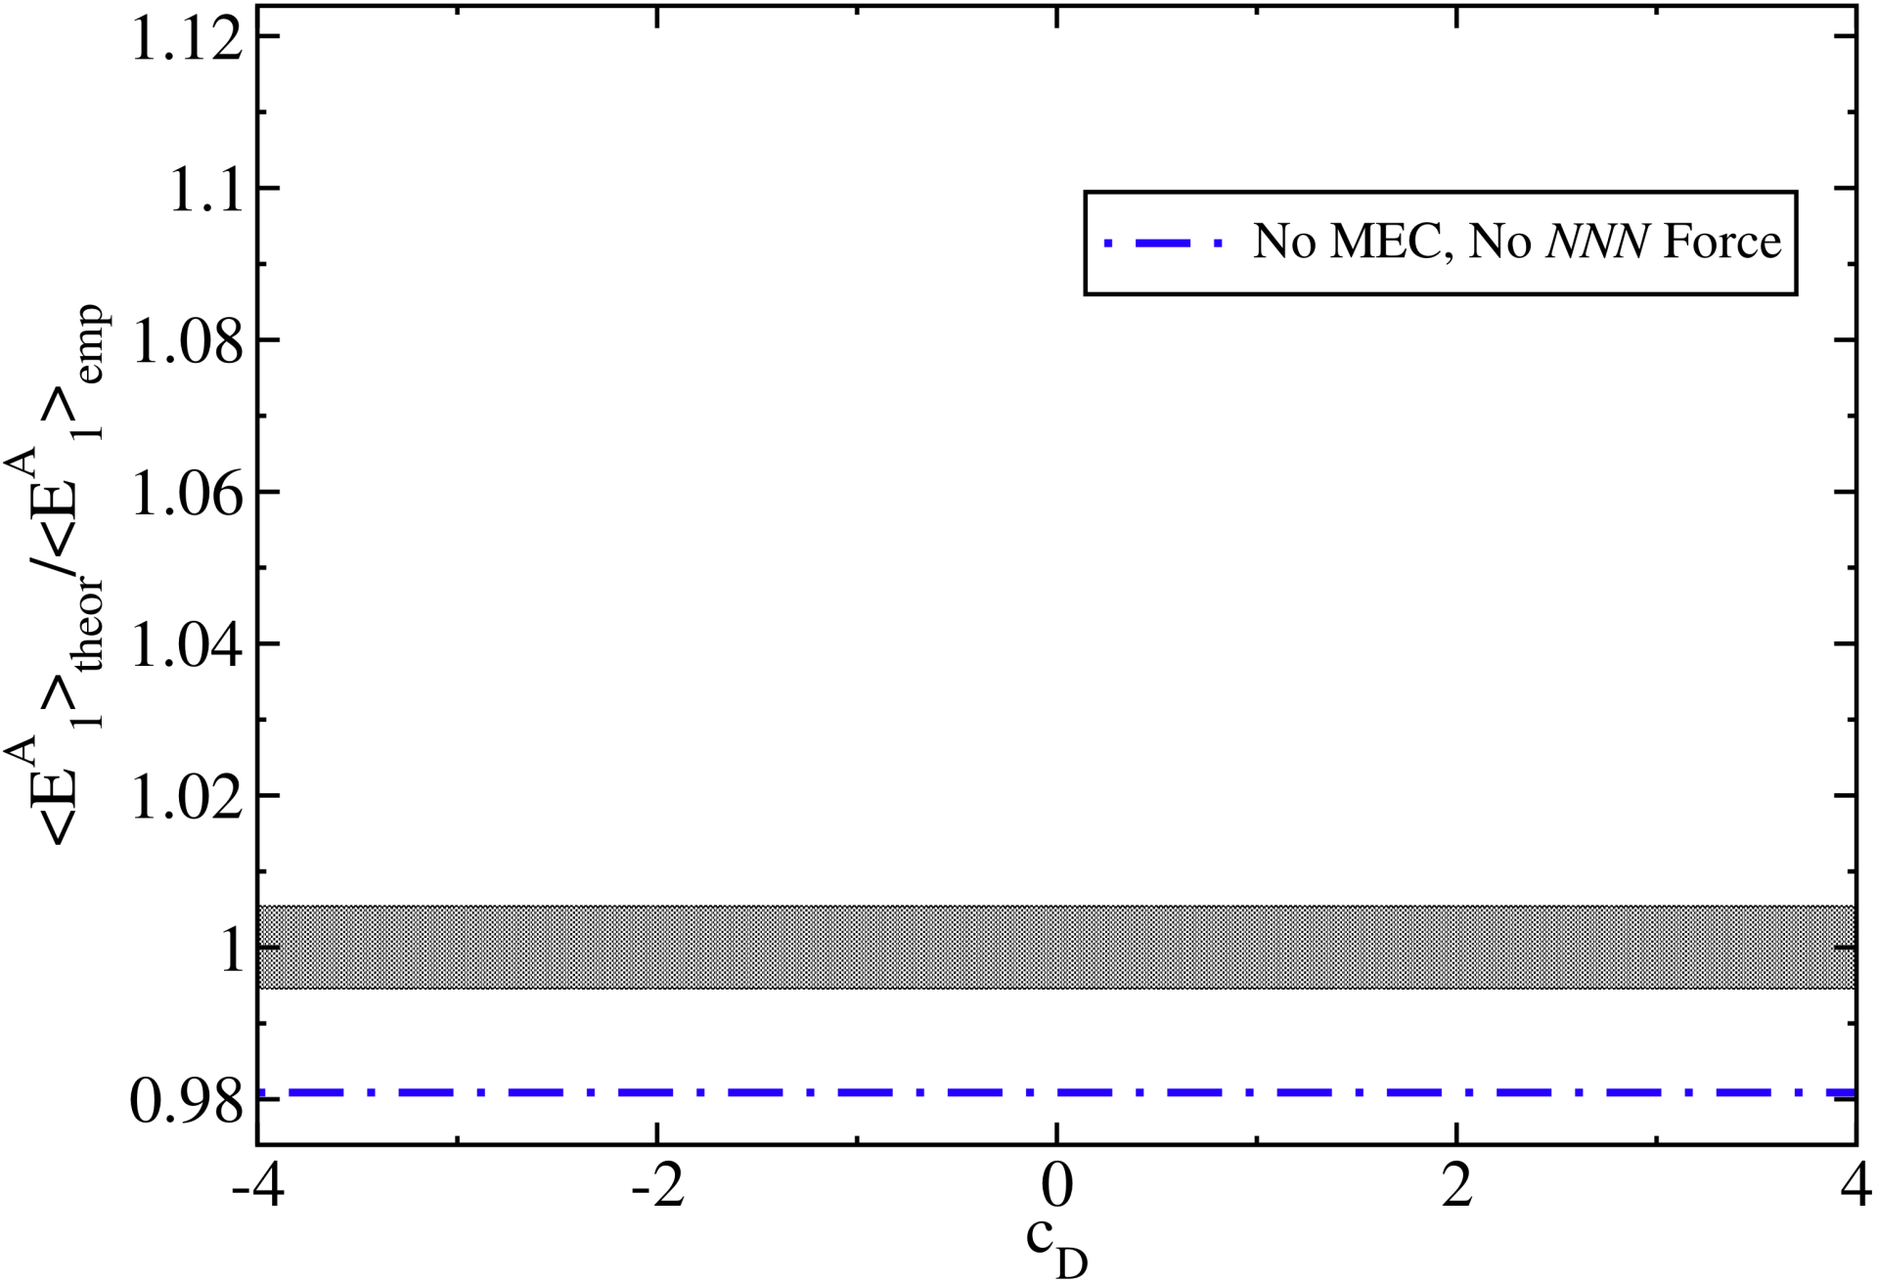
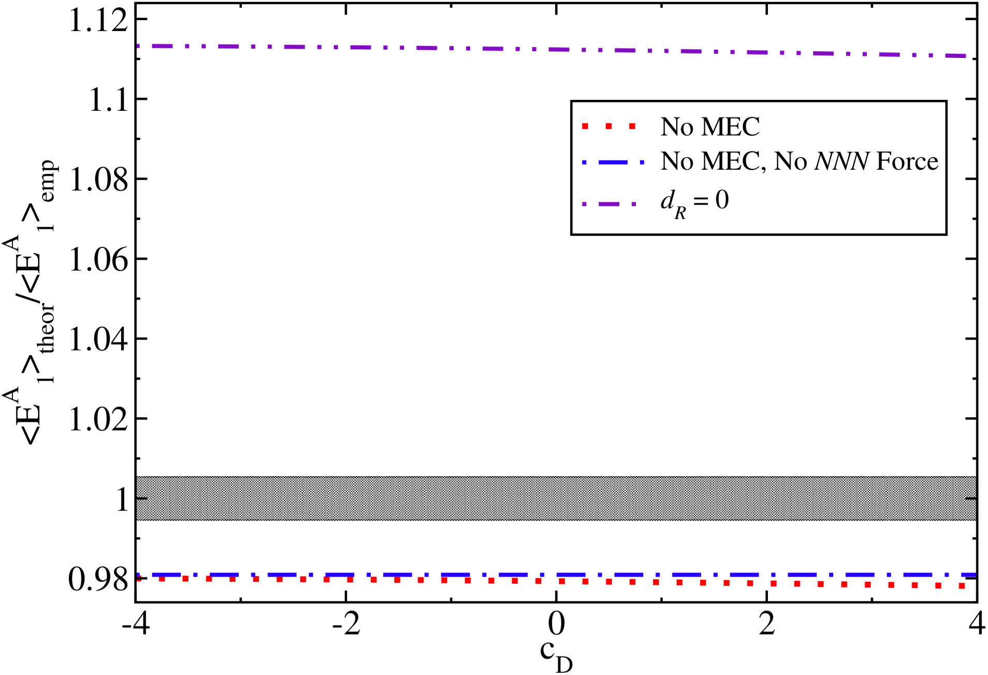
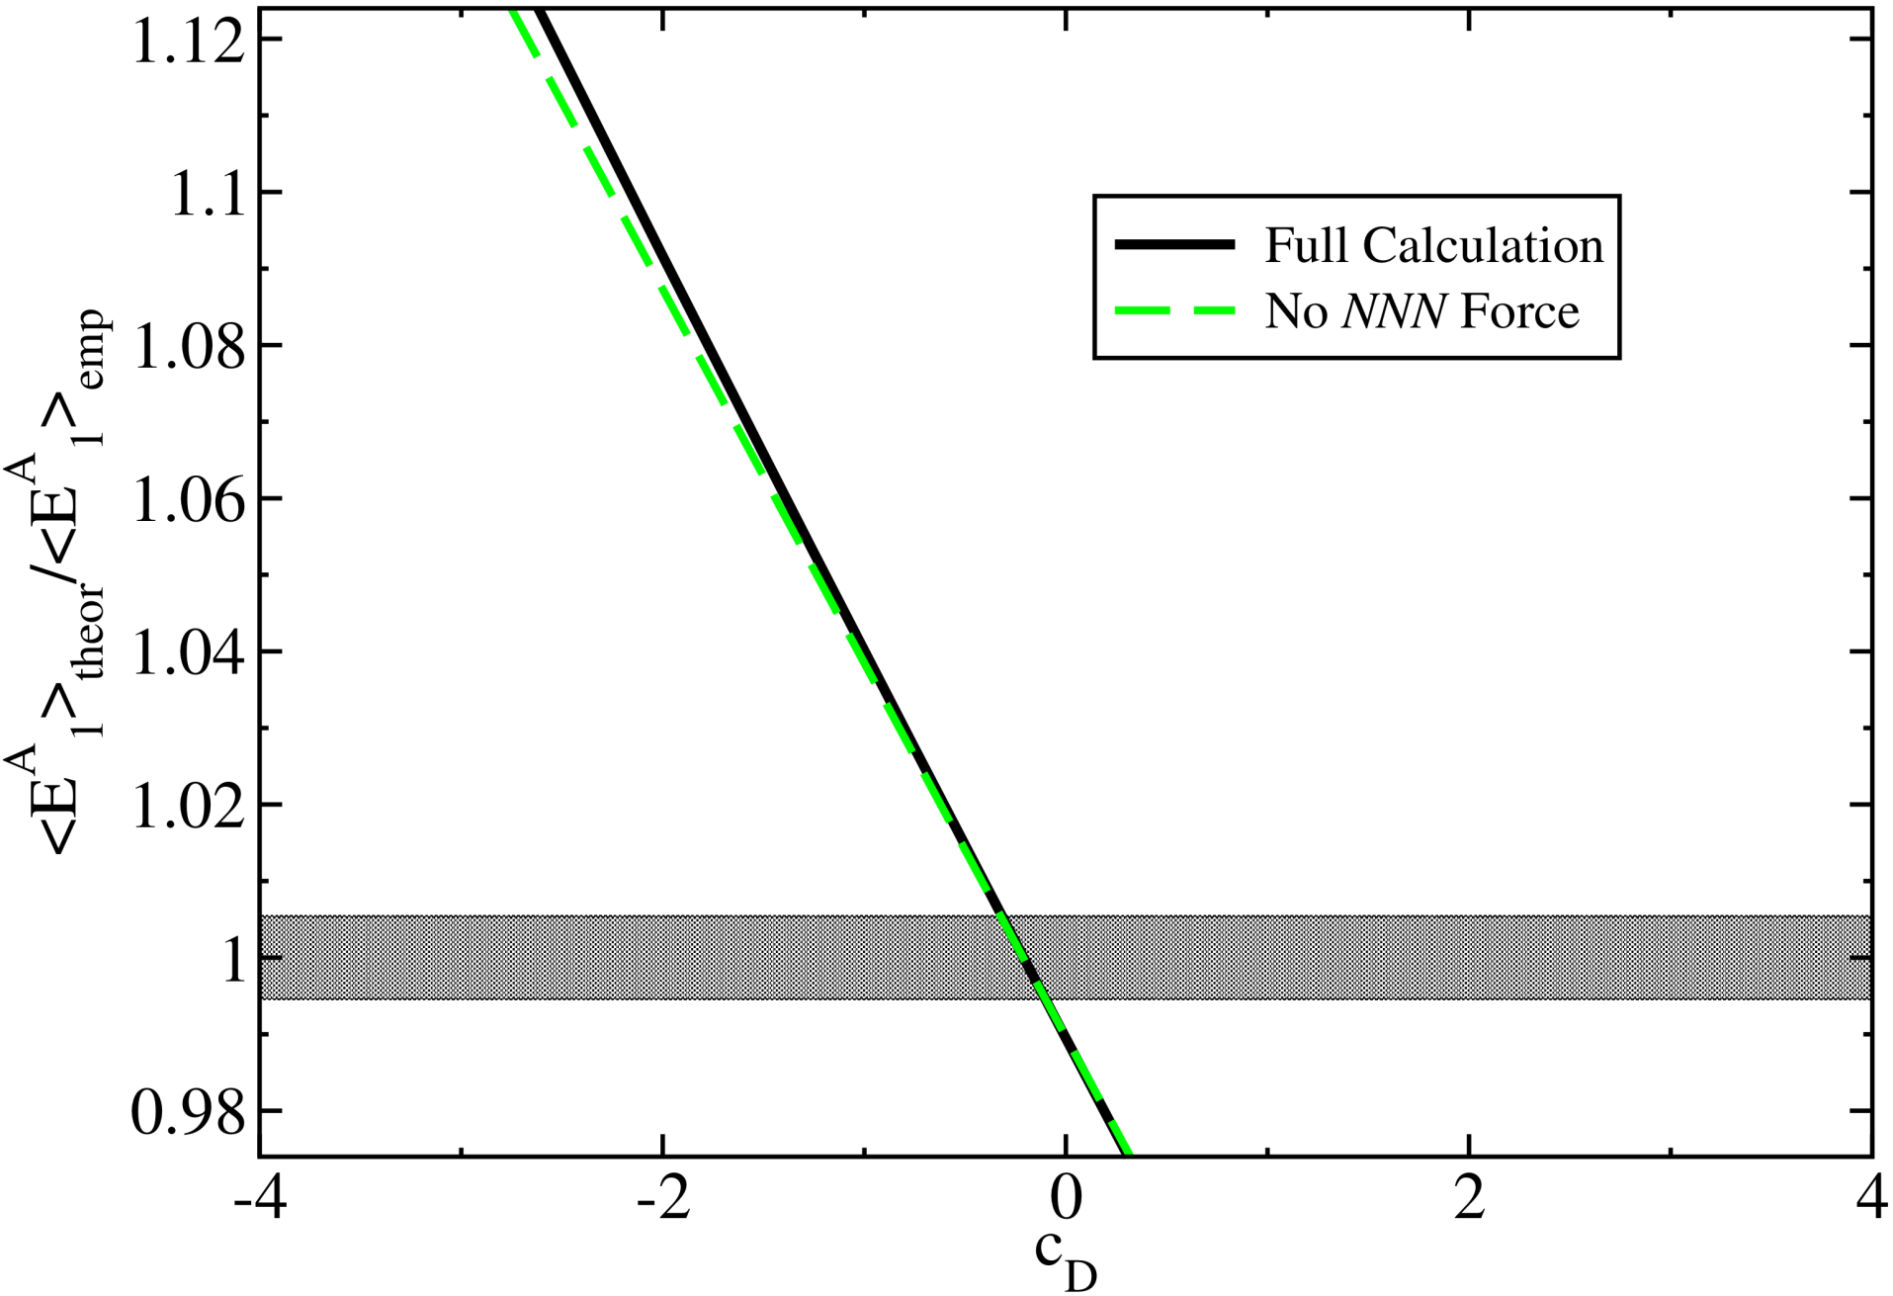
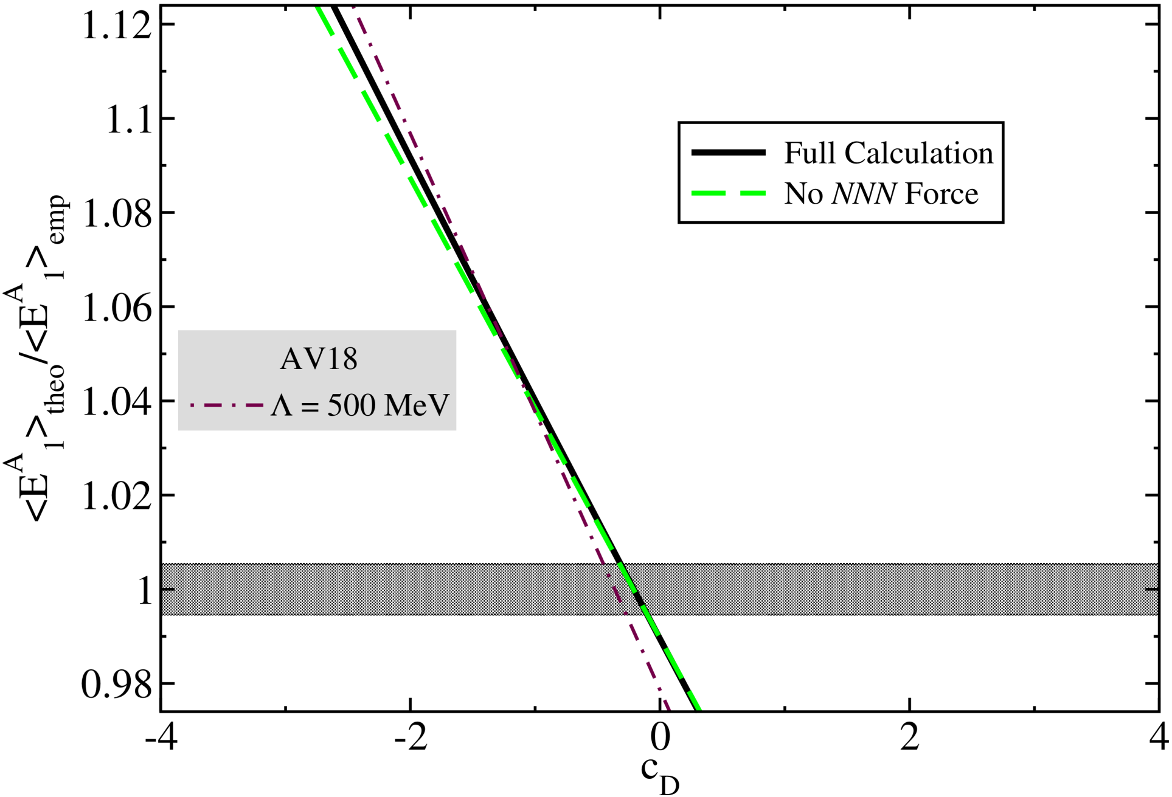
A closer look into the weak axial correlations in ³H
OPEC
Contact
Specific character of the force has minor effect
Is this the origin for the success of EFT*?
MEC – a 2% effect on the matrix element
NNN are not important???
Without the contact interaction - a disaster

Slide 19
EFT* approach for low-energy weak reactions:
Low energy EFT
QCD
Phenomenological Hamiltonian
Chiral Lagrangian
Nöther current
Solution of Schrödinger equation
Wave functions
Weak current
T.-S. Park et al, Phys. Rev. C 67, 055206 (2003), M. Rho arXiv: nucl-th/061003.

Slide 20
Applications of the EFT* approach
Solar Fusion II, Rev. Mod. Phys. [to be published].
T.-S. Park et al, Phys. Rev. C 67, 055206 (2003).
R. Schiavilla et al, Phys. Rev. C 58, 1263 (1998).
M. Butler, J.-W. Chen, Phys. Lett. B 520, 87 (2001).
L. Marcucci et al, Phys. Rev. C 66, 054003 (2002)
p+p fusion in the sun.
³He+p fusion in the sun.
The weak structure of the nucleon from μ capture on ³He.
Neutrino scattering on light nuclei in core-collapse supernovae.
β decay of ⁶He and the suppression of the axial constant in nuclear matter.
DG, Phys. Lett. B666, 471 (2008).
L. Marcucci et al, Phys. Rev. C [to be published]
DG, Barnea Phys. Rev. C 70, 048801 (2004); Phys. Rev. Lett. 75, 192501 (2007); Nucl. Phys. A 790, 356 (2007); Few Body Syst. (2008). DG, PhD. thesis, arXiv: 0807.0216 (2007).
O’Connor, DG, Horowitz, Schwenk, Barnea, Phys. Rev. C 75, 055803 (2007).
Vaintraub, Barnea, DG, Phys. Rev. C, 79 065501 (2009).

Slide 21
Gamow-Teller transitions

Slide 22
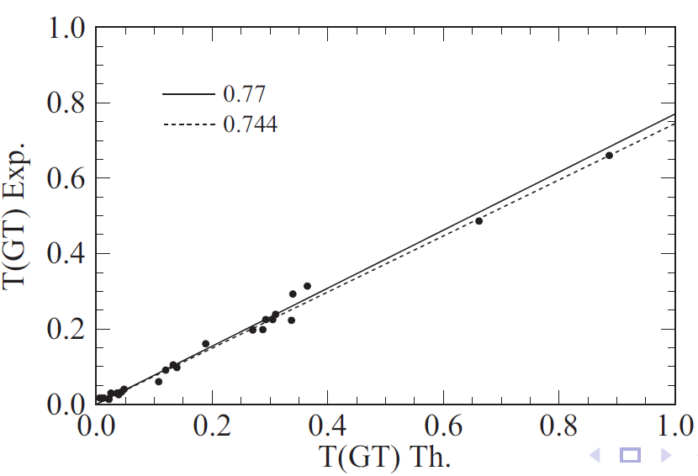
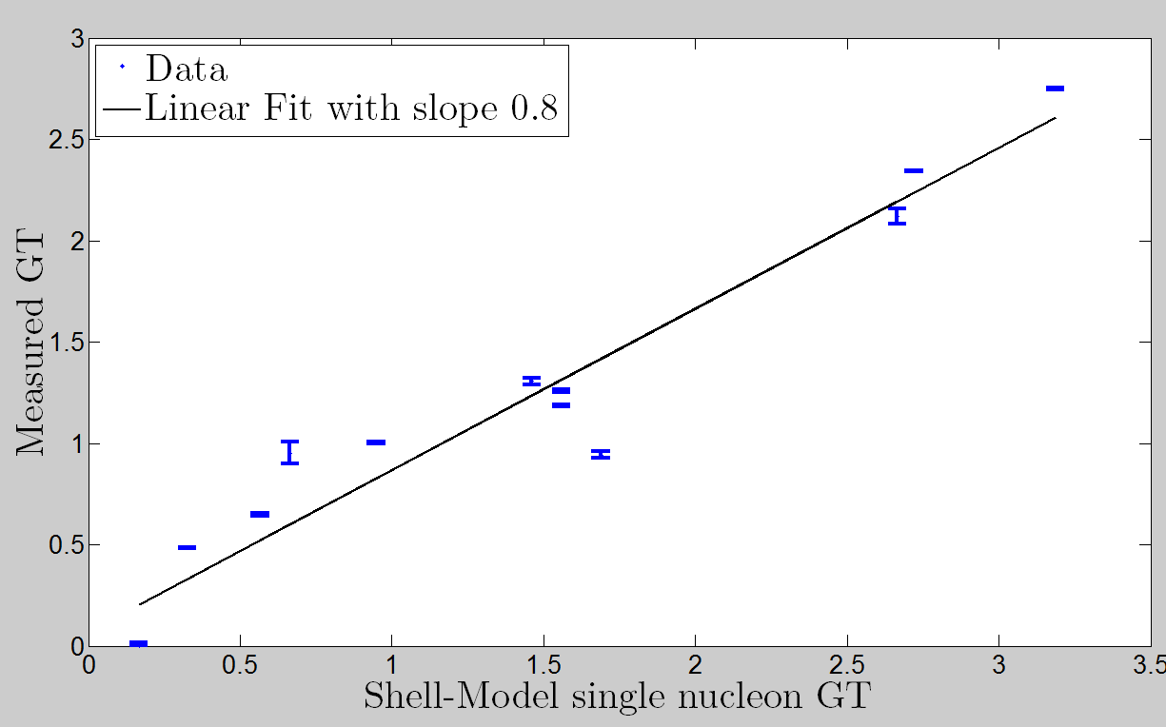
Suppression up to A=18 (J_{i/f}=0)
sd shell
pf shell
Chou, Warburton, Brown, Phys. Rev. C47, 163 (1993)
Martinez-Pinedo et al, Phys. Rev. C53, 2602 (1996)
QRPA calculations reach similar results.
Measurements of Ikeda sum-rule in ⁹⁰Zr up to high energies
Alvarez-Rodriguez et al, Phys. Rev. C70, 064309 (2004)
Sesano et al, Phys. Rev. C79, 024602 (2004); Yako et al, Phys. Lett. B615, 193 (2005)

Slide 23
g_{A} Quenching in nuclear matter:
An effect that seems to increase with A.
This is not surprising:
Nucleons interact in nuclei.
Axial current is not conserved.
However:
A VMC calculation of the β decay ⁶He(0⁺)→⁶Li(1⁺) used AV18/UIX with phenomenological MEC and found:
Single nucleon GT strength overestimates by 4% the experimental strength.
Adding MEC worsens the overestimation to 5.4%.
Are the VMC wave functions to blame?
Are the MEC to blame?
Pervin et al., Phys. Rev. C 76, 064319 (2007).
Schiavilla and Wiringa, Phys. Rev. C 65, 054302 (2002).

Slide 24
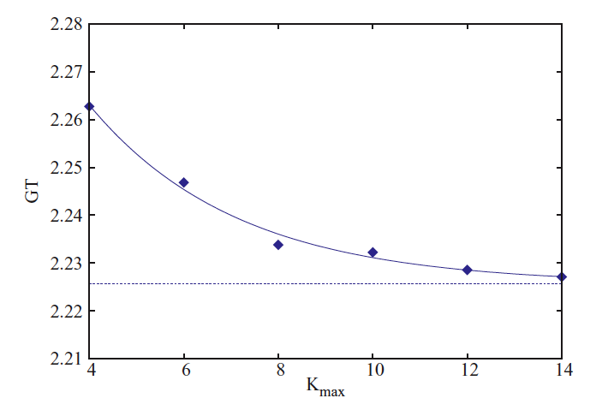
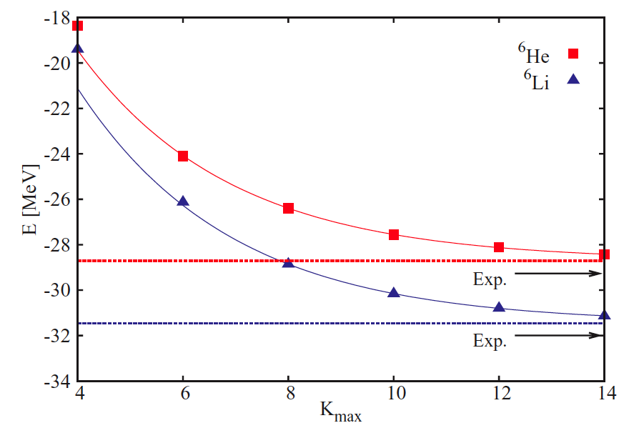
⁶He β⁻ decay
We use the HH method to solve the 6 body problem, with JISP16 NN potential.
We use χEFT axial MEC with c_{D} fixed using triton β decay
Very rapid convergence:
E∞(⁶He)=28.70(13) MeV
E_{exp}(⁶He)=29.269 MeV
E∞(⁶Li)=31.46(5) MeV
E_{exp}(⁶Li)=31.995 MeV
GT|_{LO}=2.225(2)
GT=2.198(2)
Vaintraub, Barnea, DG, Phys. Rev. C, 79 065501 (2009).

Slide 25
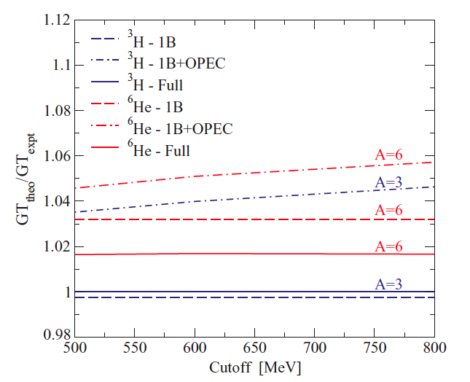
⁶He β decay
OPEC
Contact
The contact interaction that does not exist in pheno. MEC, has an opposite sign with respect to the long range one.
The final GT is just 1.7% away from the experimental one!
MEC brings the theory closer to experiment!
No dependence on the cutoff!
|GT|^{JISP16}(⁶He)=2.198(7)
|GT|^{exp}(⁶He)=2.161(5)
Vaintraub, Barnea, DG, Phys. Rev. C, 79 065501 (2009).

Slide 26
⁶He β decay and a hint to heavier nuclei
The inclusion of χPT based MEC is helpful, even when one uses phen. interaction.
The conclusion is that the weak correlations inside the nucleus can lead to (at least part of) the observed suppression.

Slide 27
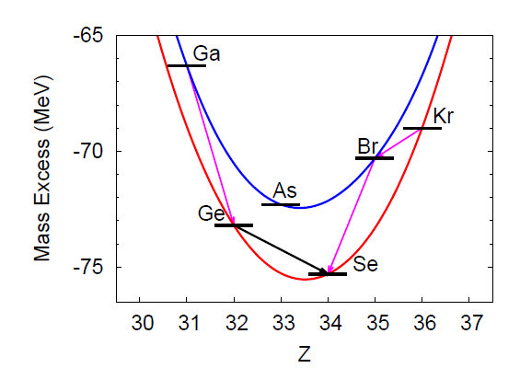
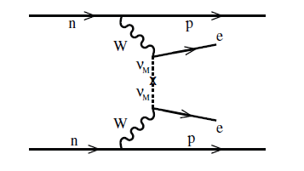
0νββ decays
Menendez, DG, Schwenk, in preparation.
Rare second order weak decays.
Needs massive Majorana neutrino ( ).
High momentum transfer ~100MeV/c, with respect to β decay, 2νββ.
Biggest uncertainty is in the NME:
Value of g_{A} at 100 MeV/c.
Nuclear calculation.
NME needed:
Estimate effective ν mass.
Predict the favorable decays.
Catch systematic effects.

Slide 28
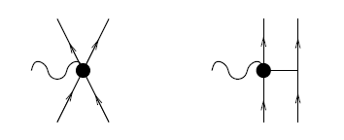
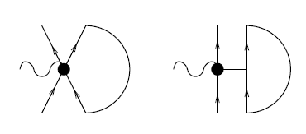
Reducing 2b-current to 1b-effective current
The 2-b currents are very hard to calculate in many-body approximations.
We sum over one nucleon within a Fermi-gas approximation.
exact for spin saturated nuclei
Both for direct and exchange terms.
Park, Jung, Min, Phys. Lett. B409, 26 (1997).

Slide 29
Reducing 2b-current to 1b-effective current
The total scattering operator:
The effects of the 2b-current:
At p=0 reduction of 1b GT term.
Increase as p grows.
Proportional to ρ ➔enhanced in medium-heavy nuclei.
Menendez, DG, Schwenk, in preparation.

Slide 30
Fixing c_{D}
We fix c_{D} to reproduce the p=0 GT quenching, assuming that all the quenching is due to exchange currents:
Around the experimental value: q=0.96.
Around the theoretical discrepancy: q=0.74.
So:

Slide 31
1b+2b current as a function of density

Slide 32
Effect of 2b currents on GT

Slide 33
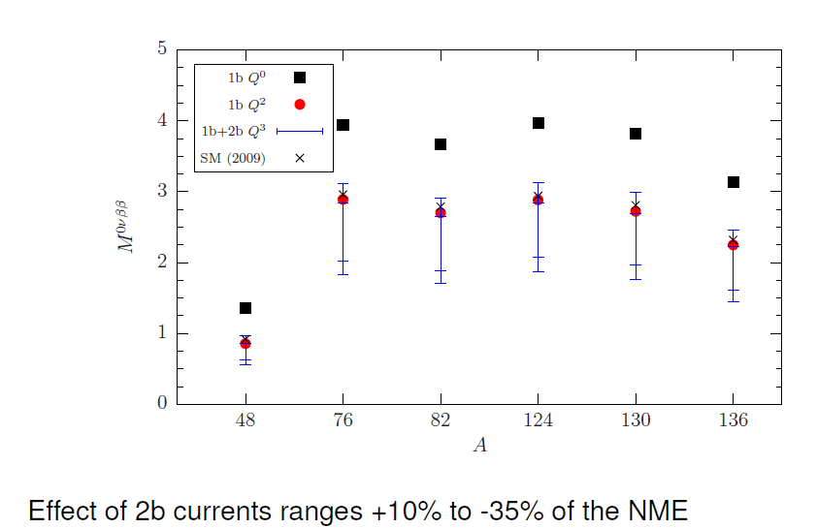
Predictions for 0νββ matrix element

Slide 34
Summary
Using χPT to calculate weak reactions with nuclei can be useful to:
Constrain the Nuclear interaction.
Give information regarding the structure of the nucleus.
Extract microscopic information about the fundamental theory and its symmetries.
Hint to the in-medium evolution of nucleonic properties.
Help infer how currents evolve with nuclear density.
Probe the limits of the standard model.

Slide 35
Collaborators
Achim Schwenk, J. Menéndez
Petr Navratil
Sofia Quaglioni
Nir Barnea, Sergey Vaintraub
Finance: BMBF ARCHES award.

